Slide 1
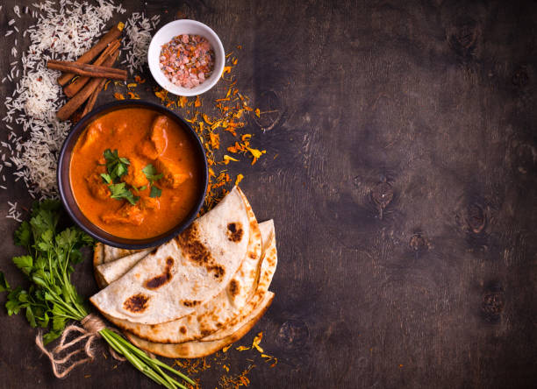
Indian Cuisine-
a vivid study on Indian diet
-A research project by- SAPTATI BAGAL

Slide 2
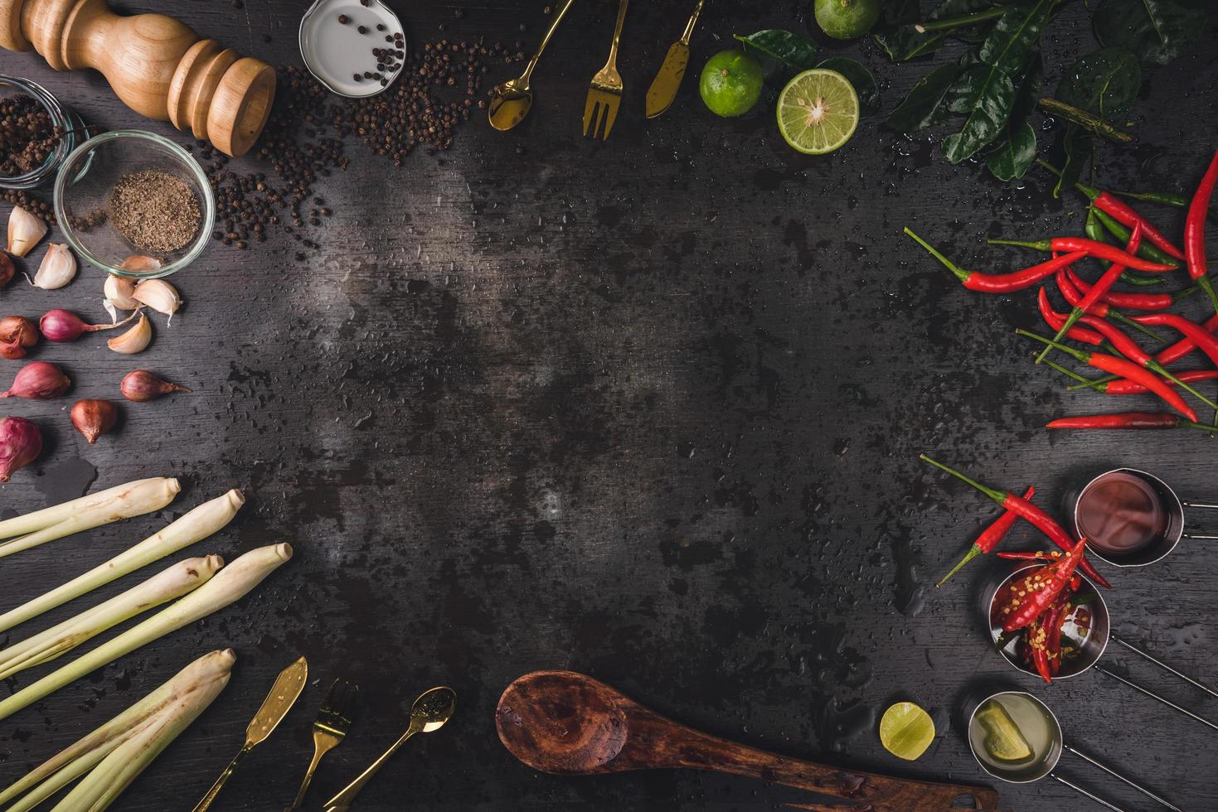
CONTENT-
Introduction – Food and Indian cuisine
Insight to the dataset
List of Indian cuisine – different course
Analysis of nutrition
Final conclusion

Slide 3
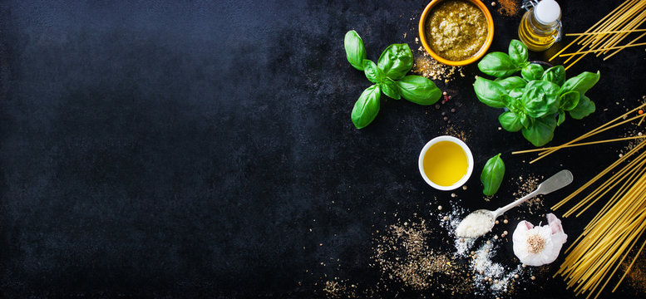
Introduction- Food and Indian cuisine
Food is not just a source of sustenance; it is an integral part of culture, identity, and tradition. Across the globe, diverse cuisines reflect the unique flavors, cooking techniques, and ingredients prevalent in different regions. One such rich and diverse culinary tradition is Indian cuisine.
Indian cuisine is not only a celebration of flavors and aromas but also a treasure trove of nutritional goodness. By incorporating a variety of spices, ingredients, and cooking techniques, Indian dishes offer a holistic approach to nourishment, promoting both physical health and culinary delight.

Slide 4
Insight to the dataset
COLUMN NAME | DATATYPE
Food_items | text
Breakfast | int
Lunch | int
Dinner | int
VegNovVeg | int
Calories | int
Fats | double
Proteins | double
Iron | double
Calcium | int
Sodium | int
Potassium | int
Carbohydrates | double
Fibre | double
VitaminD | int
Sugars | double
Dataset Credit- Kaggle.com
This Dataset comprises of only one table- The cuisine table
Here is the list of all the columns present and their respective data type

Slide 5
List of Indian Cuisines-
Breakfast
Food Items | Food Items | Food Items | Food Items | Food Items | Food Items
Kadhi | Milk | Dosa | Bhaji Pav | Sweet Dahi | Strawberries
Bananas | Cashew Nuts | Idli | Almonds | Cornflakes | Kiwi
Mango Chutney | Orange | Poha | Mushrooms | Laal Chai | Nachos
cheese | Pears | Tomato | Egg Yolk | Pumpkin seeds | King Fish
Coffee | Glucone'D | Dahi | Sweet Potatoes | Chocos | Banana Chips
Corn | Dairy Milk | Cake | Masala Aloo | Chai | Honey
Grapes | Fruit and Nut chocolate | Uttapam | Orange juice | Apples | Chocolate milk

Slide 6
Lunch-
Food Item | Food Item | Food Item | Food Item | Food Item | Food Item | Food Item | Food Item | Food Item
Aloo Tikki | Corn | Rohu Curry | Gulab Jamun | Tomato | Mushrooms | Butter Paneer | Kiwi | Mixed Veg
Bread made in wheat | Paneer Tikka | Onion Pakoda | Jalebi | Dahi | Sweet Potatoes | Salmon | Mutton | Nachos
Baati | Maggie | Butter Chicken | Dosa | Chowmein | Masala Aloo | Beans | Boiled Chicken | Chicken Popcorn
Brown Rice | Aloo Matar | Chicken Kolapuri | Idli | Uttapam | White Rice | Dal Fry | Kebab | Nalli Nihari
Cauliflower | Sitafal | Chicken 65 | Chappati | Dal Makhani | Sweet Dahi | Red Sauce Pasta | Tomato Rice | Fish Eggs

Slide 7
Dinner
Food Item | Food Item | Food Item | Food Item | Food Item | Food Item | Food Item | Food Item | Food Item | Food Item
Aloo Tikki | Bhel Puri | Rohu Curry | Chicken Kolapuri | Dosa | Uttapam | Butter Paneer | Boiled Chicken | Mixed Veg | Fish Eggs
Bread made in wheat | Milk | Surmai | Chicken 65 | Idli | Dal Makhani | Salmon | Chicken Tandoori | Chicken sausage | Honey
Baati | Paneer Tikka | Veg Pizza | Gulab Jamun | Chappati | Mushrooms | Beans | Kebab | Malai Chicken | Chocolate Icecream
Brown Rice | Maggie | Cheese Pizza | Jalebi | Tomato | Masala Aloo | Dal Fry | Tomato Rice | Nachos | Vanilla Ice cream
Cauliflower | Aloo Matar | Onion Pakoda | Dairy Milk | Dahi | White Rice | Red Sauce Pasta | Prawns | Chicken Popcorn | Strawberry Icecream
Corn | Sitafal | Butter Chicken | Fruit and Nut chocolate | Chowmein | Sweet Dahi | Mutton | Momos | Nalli Nihari | Rasmalai

Slide 8
Analysis of Nutrition-
Essential Nutrients in diet- Essential nutrients are substances that the body cannot produce on its own or in sufficient quantities, so they must be obtained through diet. These nutrients play crucial roles in various physiological processes and are essential for maintaining overall health and well-being.
Protein content in food items-

Slide 9
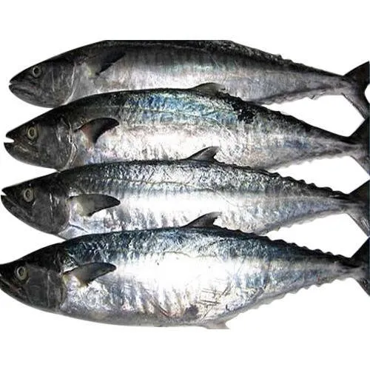
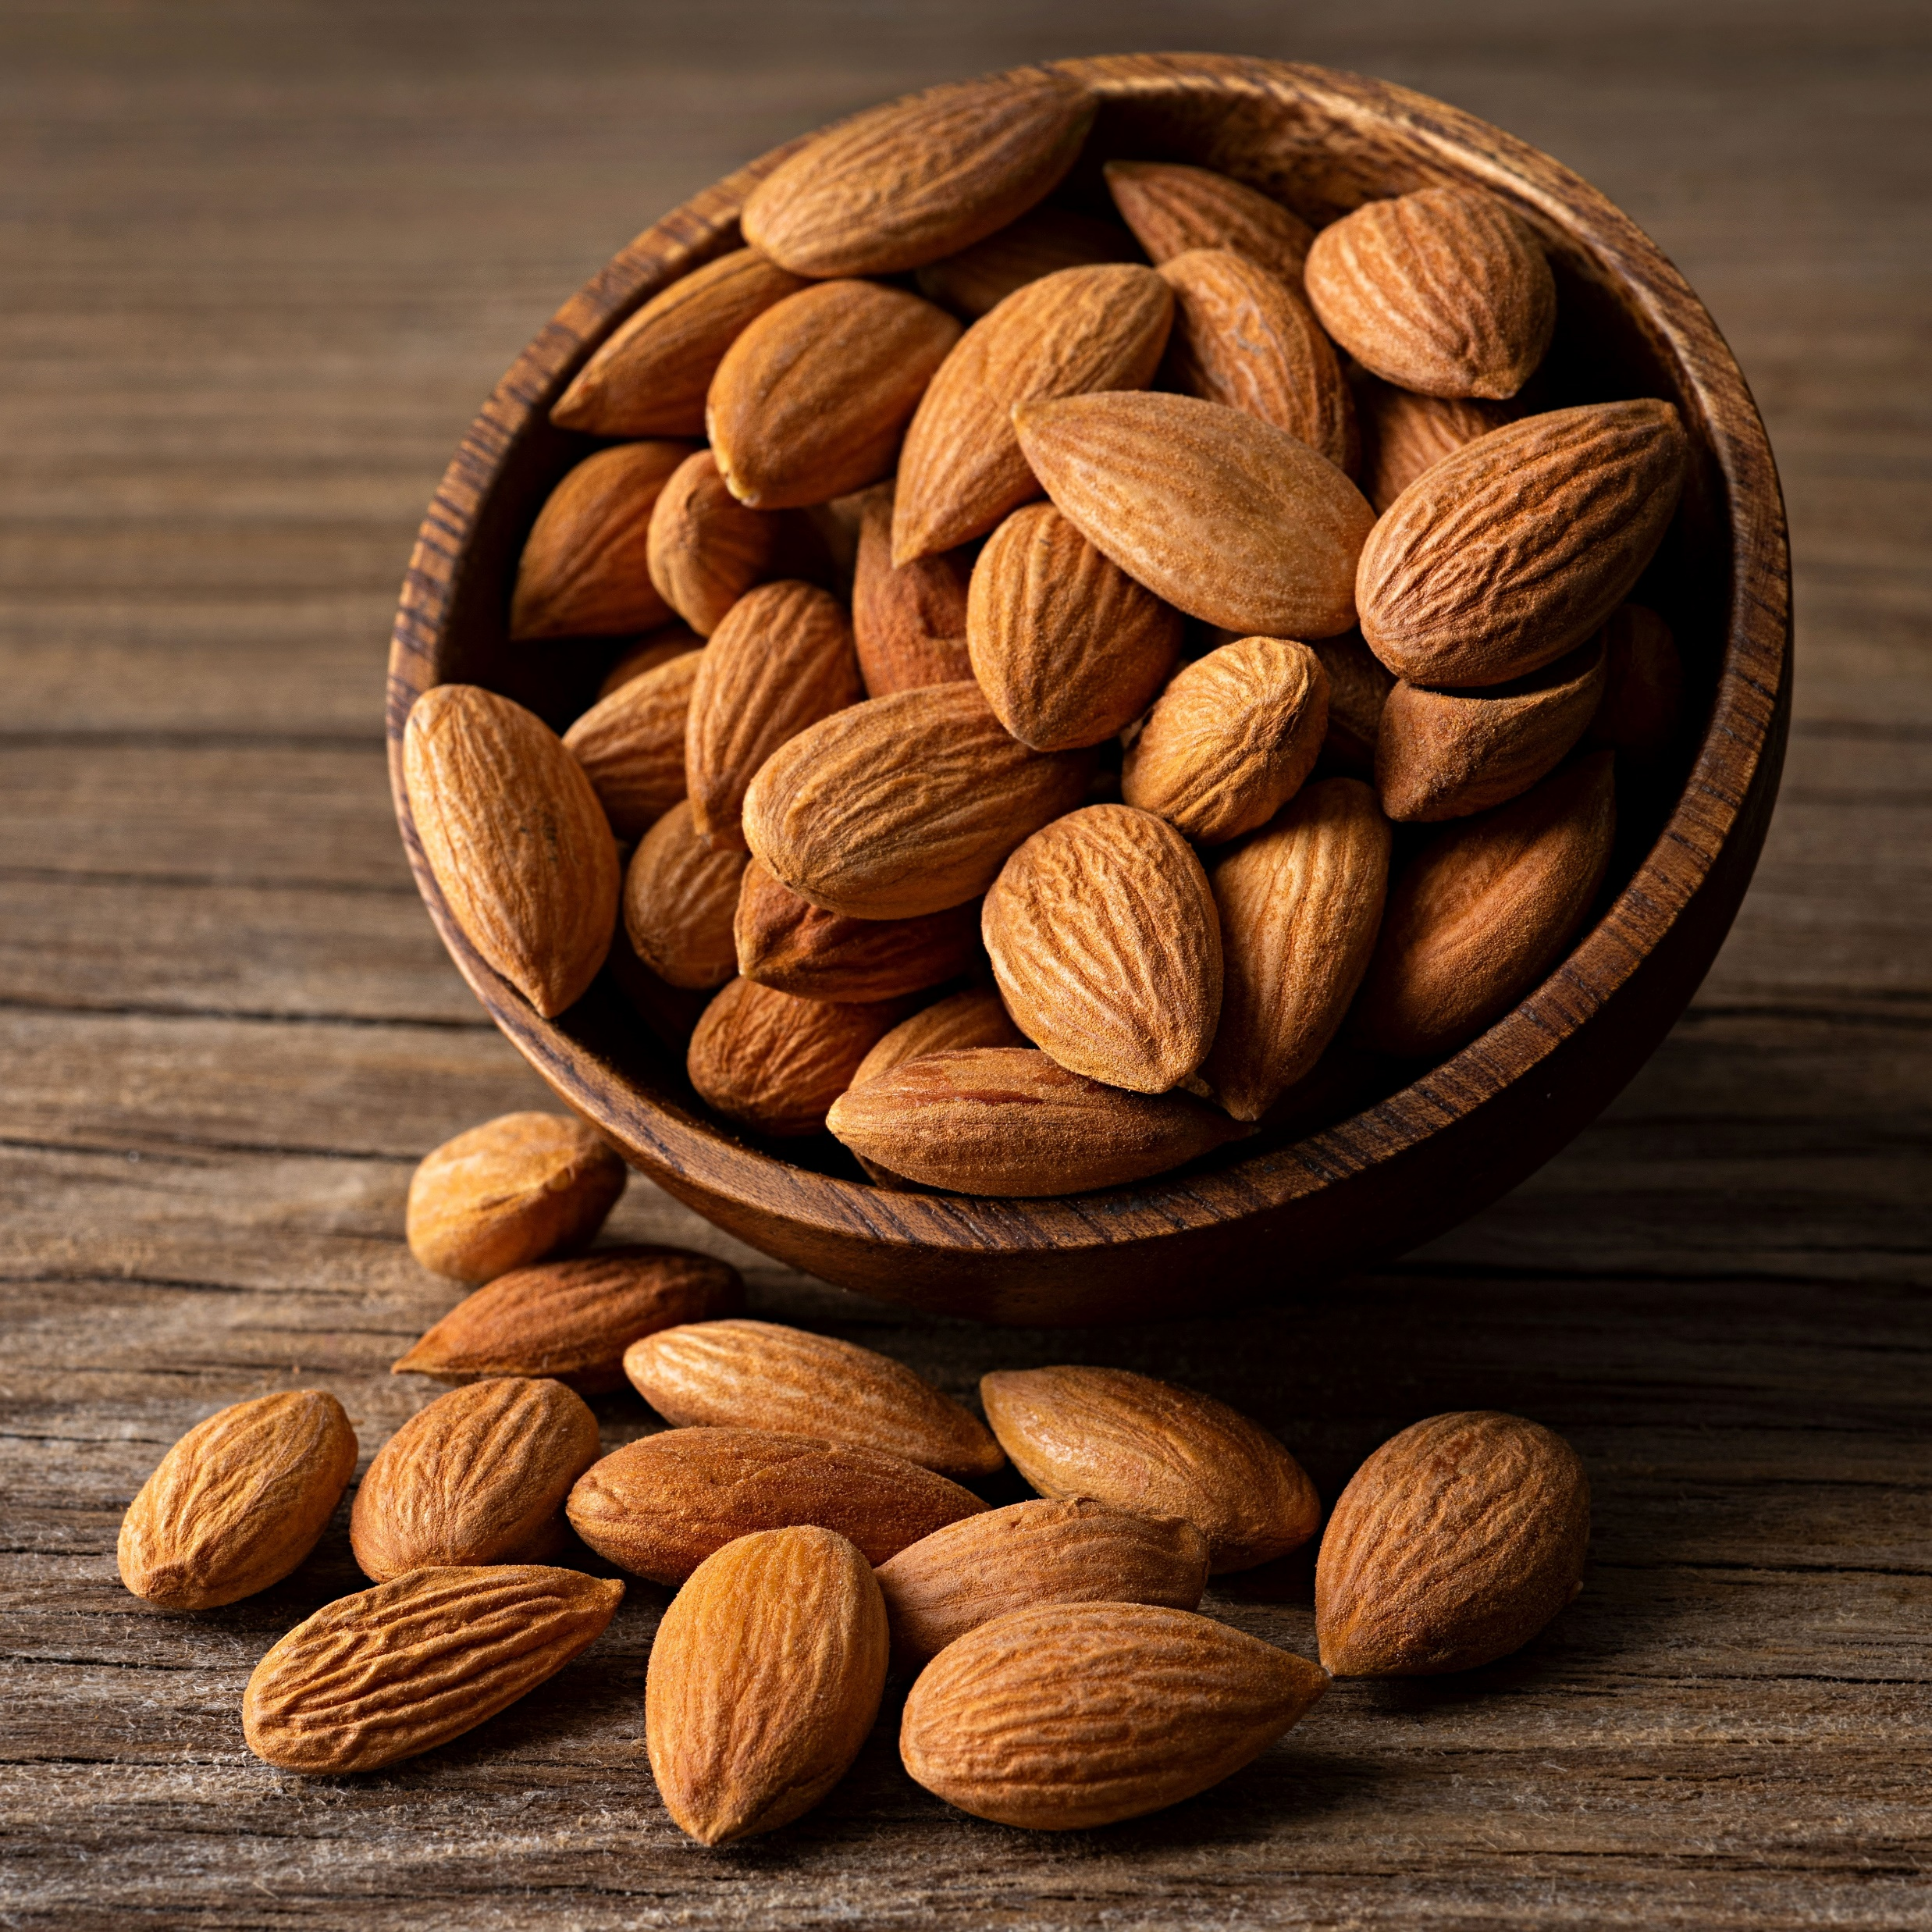
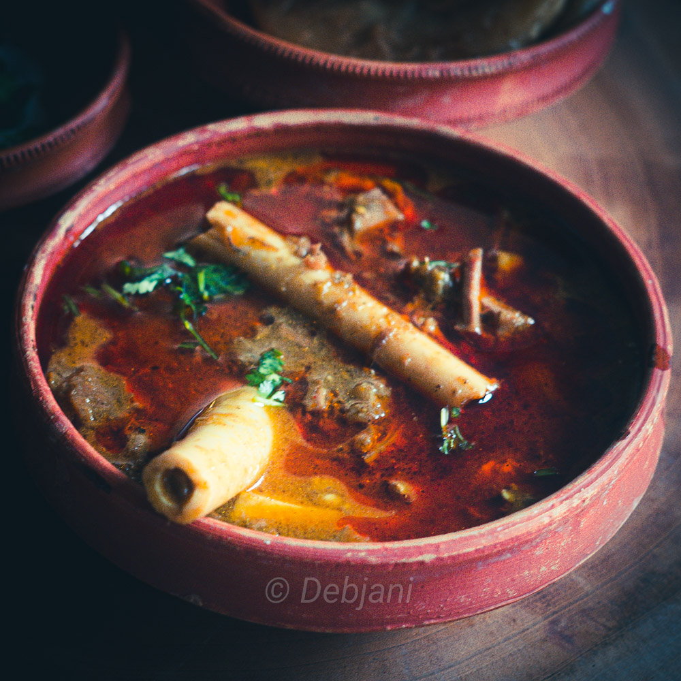

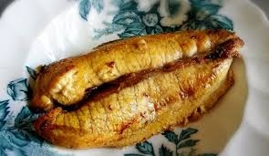
Some High-Protein Food Items-
Surmai fish
Almonds
Nalli Nihari
Glucon-D
Fish egg

Slide 10
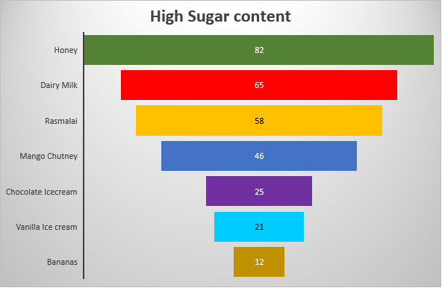
Calorie content in food-(here 1Calorie = 1 kcal)
Though Almond have highest protein content but have a relatively higher sugar content whereas king fish have a relative lower protein than almond but the sugar content is 0 which is more healthy.
Honey have the highest Sugar content

Slide 11
Why is Vitamin D essential for our body?
Absorption of Calcium in our body
Helps in the muscle and immune system
Helps in cell growth and development
Why is Fibers important for our body?
Prevention of Digestive Disorders
It controls Blood sugar Level
Weight Management: Foods high in fiber tend to be more filling and can help promote satiety, leading to reduced overall calorie intake.

Slide 13
FINAL CONCLUSION

Slide 14
Surmai is the most protein rich food among all non-veg food items.
Fish egg is the second most protein rich food
Almonds is the most protein rich food among all veg Indian food items

Slide 15
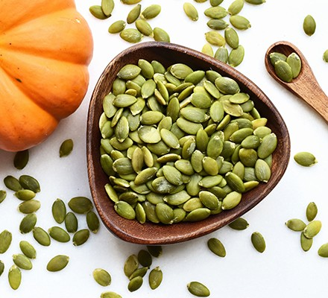
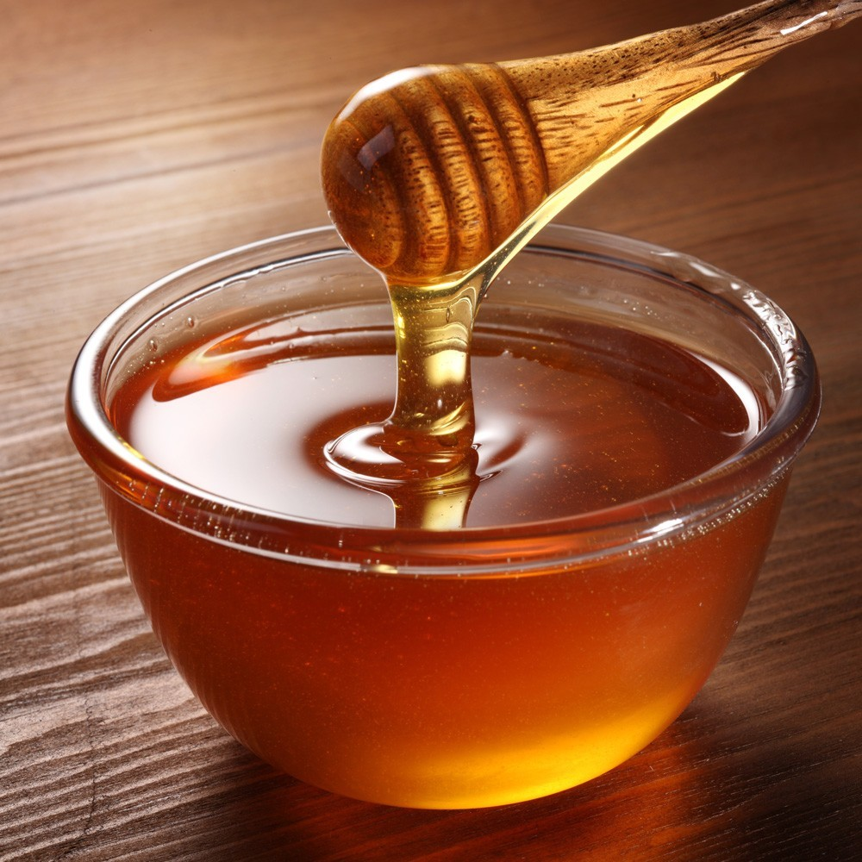
Pumpkin Seeds have high amount of protein and the sugar content is 0
But Almonds have very high protein but also have a certain amount of sugar content.
Honey have the highest sugar content
Banana have a comparatively high sugar content than any other fruits.

Slide 16
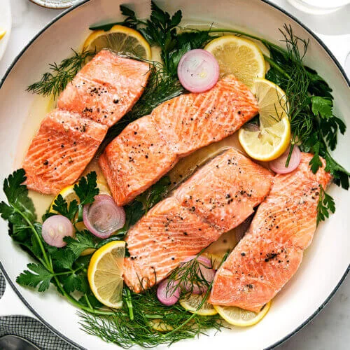
Salmon is very rich in Vitamin-D whereas Egg yolk also have a comparatively good amount of Vitamin-D
Pumpkin seeds have the highest amount of fiber content in it.

Slide 17
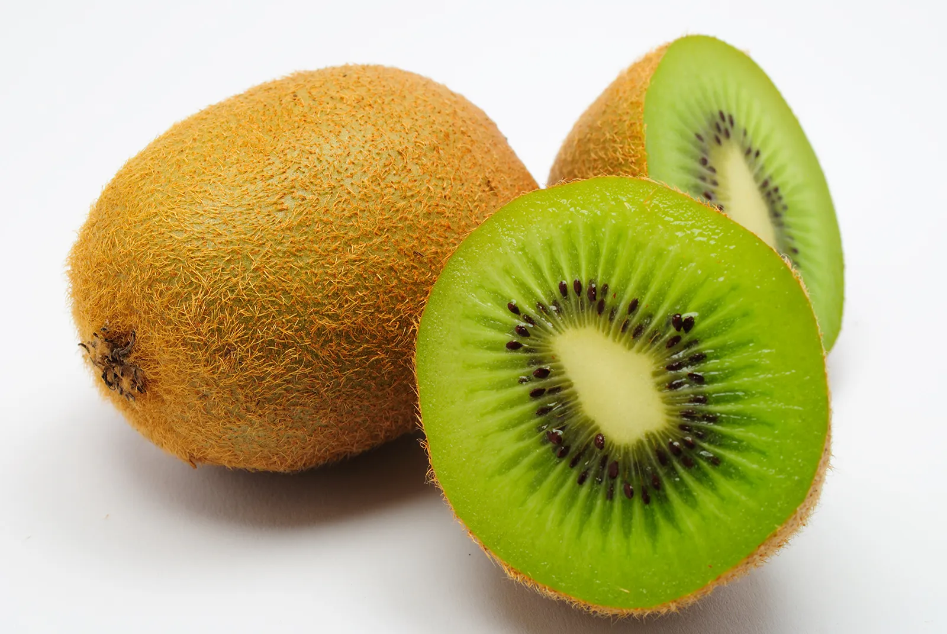
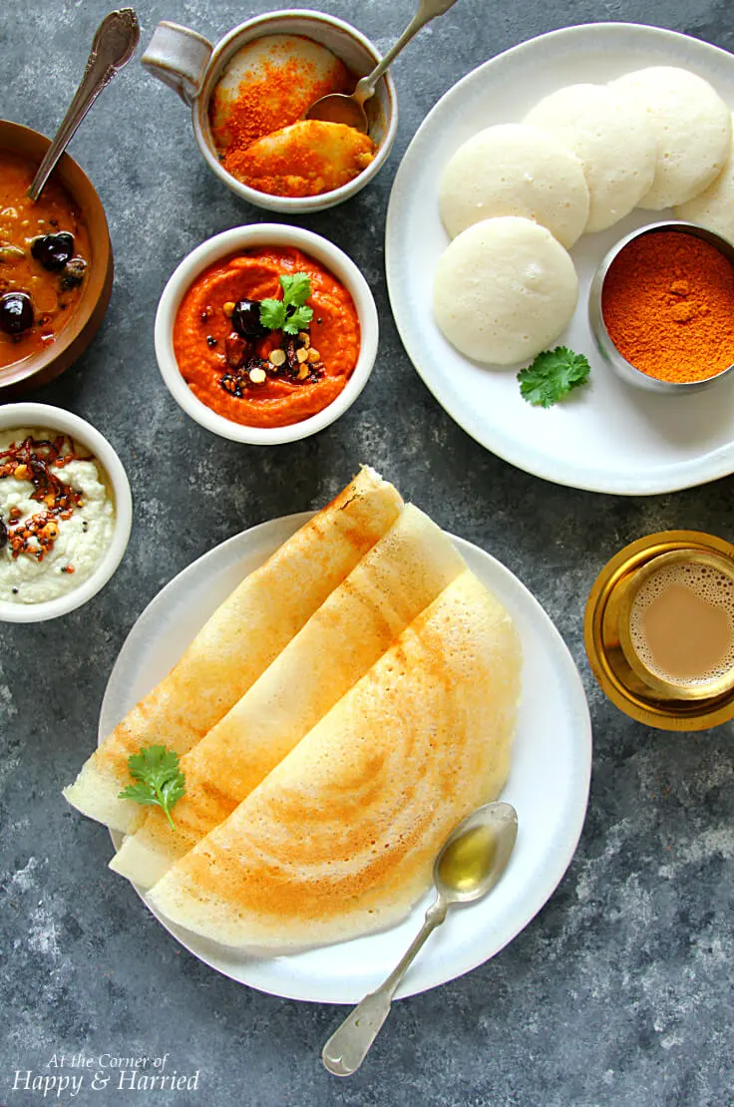
Among fruits Kiwi has the most balanced amount of Carbs,fat and protein in it.
Idle and Dosa are food items that have balanced amount of essentials nutrients i.e Carbohydrate,fat and protein content in it

Slide 18
Thank You

